Slide 1
EECS 498 System Design of a Search Engine
Winter 2026
Lecture 19: Ethics
Nicole Hamilton
https://web.eecs.umich.edu/~nham/
nham@umich.edu

Slide 2
agenda
details
tee shirts
where you should be
how to be successful
ethics
the intersection of ethics and technology

Slide 3
agenda
details
tee shirts
where you should be
how to be successful
ethics
the intersection of ethics and technology

Slide 4
details
Please read my ranking paper. I’ve posted a new version on Canvas with appendices describing the BNF of the query language and the heuristics and parameters I used.
Lab this week (maybe next) will be on getting starting on GCP. You’ll go from logging in the first time to building and running your LinuxGetSsl utility.
Team presentations and demos.
    Thursday April 16 (4 weeks left!)
    Friday April 17
    Tuesday April 21 (last day of class)
We are now into fun topics while you build your engines. Today will be ethics. I’m thinking negotiations next.

Slide 5
agenda
details
tee shirts
where you should be
how to be successful
ethics
the intersection of ethics and technology

Slide 6
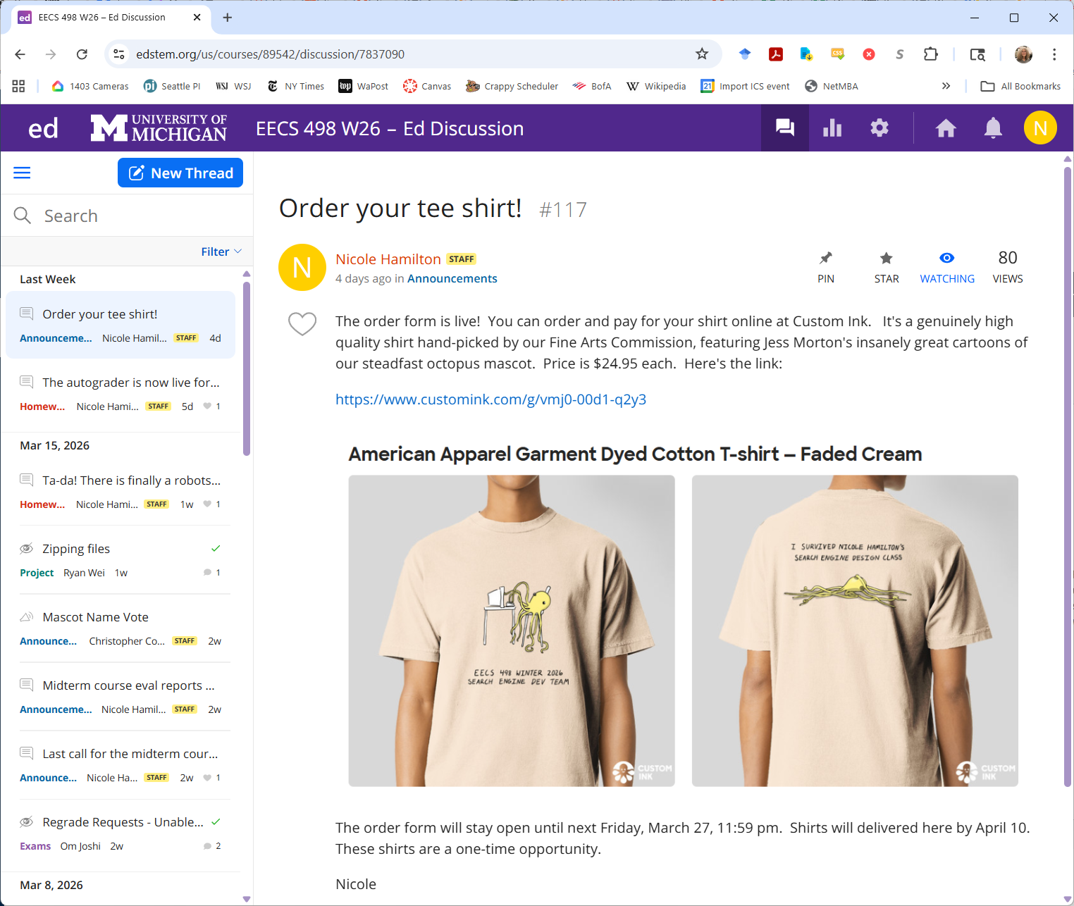

Slide 7
agenda
details
tee shirts
where you should be
how to be successful
ethics
the intersection of ethics and technology

Slide 8
where you should be
I don’t think any team has a complete build of a whole system with all the pieces.
That should be your immediate objective: A complete build of everything hooked together with no compile or link errors.
It’s okay if major pieces don’t yet work or are stubbed out, e.g., a ranker that always rates every page as excellent.
This will help you finalize your strategy and your interfaces, identify what’s missing, and decide where to put your effort.

Slide 9
stretch goals
You should be finalizing your decisions on stretch goals, e.g.,
Anchor text.
Snippets.
Word-breaking and indexing URLs.
Indexing PDFs.
Stemming or stop words.
Porn suppression.
Gradient descent or other ML technique.
More refined query language, e.g., site: or intitle: operatives.

Slide 10
your objective
When you do your demo, this is all anyone cares about:
How good are your results and how you reported them.
How fast was your engine.

Slide 11
where you need to be
You must be ready to demo by Thursday, April 16.
You’ll want to start crawling on the cloud about a week earlier, freezing your decisions about:
How many machines you’ll use and how they’re configured,
What information you’re collecting, and
Your index and other file formats.

Slide 12
before you go to the cloud
Your crawler must be able to run continuously, restarting as necessary without operator intervention.
It can’t require that someone has to check in on it every hour on the hour 24x7.
Reliable is more important than fast in your crawler because no one is watching.
You can make bug fixes and other improvements but you won’t want to have to start over to make changes to the index.
You can continue to improve your ranker and front end right up until you demo, but you won’t be able to change what’s in the index.

Slide 13
agenda
details
tee shirts
where you should be
how to be successful
ethics
the intersection of ethics and technology

Slide 14
it’s hard
Some of you are experiencing anxiety, especially if this class has felt like drinking from a firehose.
Two teams lost members and are down to 5.
At least one team is dealing with a slacker.
The class is hard and it can feel overwhelming.

Slide 15
here’s what I know
Every team and every one of you will succeed.
But you need to work as a team and do your part.
It’s important to be a really good teammate.
And it should be fun.

Slide 16
how to be successful
You will be asked, at the end, to rate your teammates on the following attributes.
Sets high standards and delivers high quality.
Treats others with respect and respects their boundaries.
Listens to and encourages others' ideas.
Is cooperative.
Is reliable, shows up, answers emails, delivers on time.
Contributed lots of helpful ideas.
Responds constructively to suggestions or criticism.
Really stepped up to do their share of the work.
Is an excellent teammate.
If you do these things now, you will be successful and your team will be successful.

Slide 17
agenda
details
tee shirts
where you should be
how to be successful
ethics
the intersection of ethics and technology

Slide 18
You spot a valuable painting at a garage sale for $1. Can you keep that knowledge secret and buy it for $1?
Probably. But not always.

Slide 19
What if you’re an art expert, the seller is aware you’re an expert and he’s asked you if it’s worth anything?
He’s relying on you to offer an expert opinion. Whether it’s legal or not, you probably shouldn’t lie.

Slide 20
You’re selling a house and you know the roof leaks and it has carpenter ants. Must you disclose?
Yes. In most (all?) states you must disclose this by law.

Slide 21
You’re selling a house with a history: A previous occupant was murdered and there have been stories about ghosts. Must you disclose?
Deaths from natural causes do not have to be disclosed. But each state is different re: suicides, accidents and violent deaths. If it’s related to the property, e.g., a drowning in the swimming pool, it has to be disclosed.
Believe it or not, you may also be required to disclose the possibility of ghosts as a “phenomena stigma”.

Slide 22
You own a coffee shop promising “the world’s best coffee.” It’s not that great. Can you get in trouble for making a false claim?
No, this is protected as “puffery”, a promotional claim expressing a subjective view that no “reasonable person” would take literally.

Slide 23
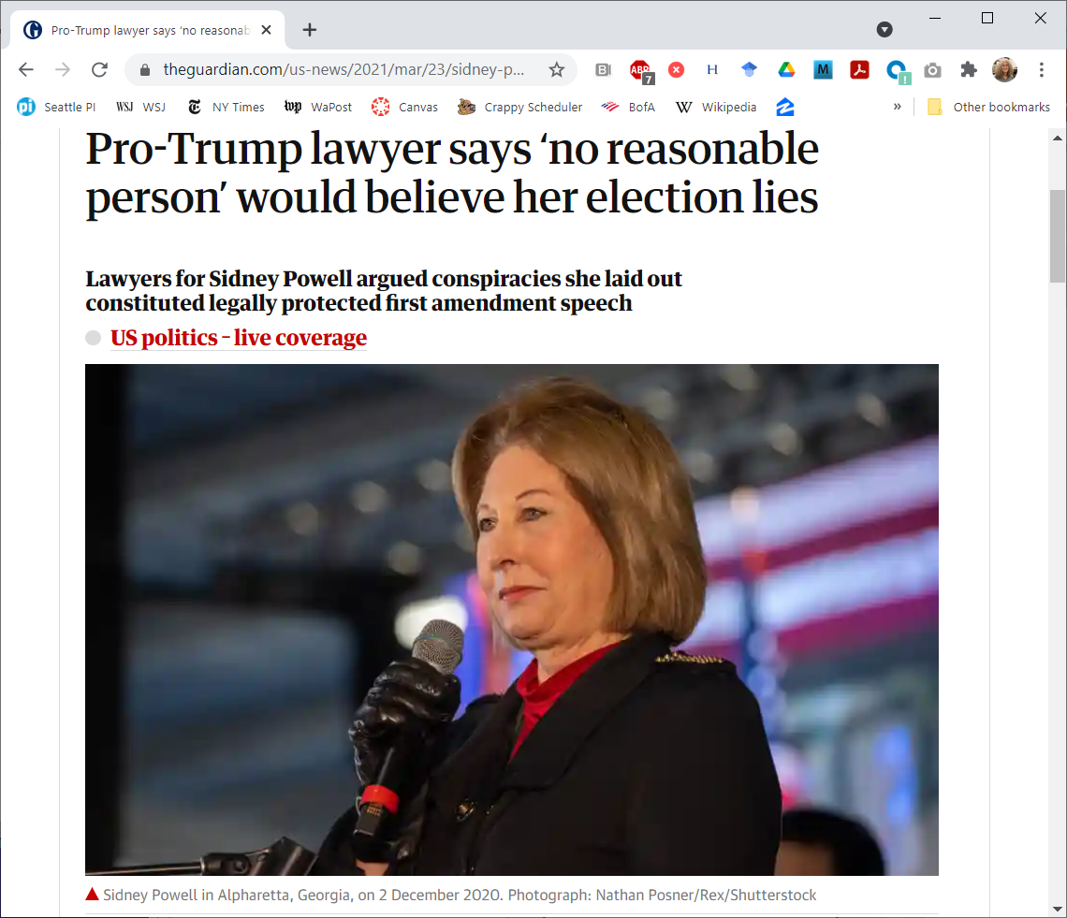
A surprise use of the puffery defense.
Powell is being sued for $1.3B by Dominion Voting Systems.
She claimed that the company was created in Venezuela to rig elections for Hugo Chavez, who died 8 years earlier.
She eventually plead guilty in the Georgia RICO case.

Slide 24
A woman is being beaten right outside your door and you see it happen. What should you do?
Sadly, most people do nothing. Sometimes, there is nothing they can do.

Slide 25
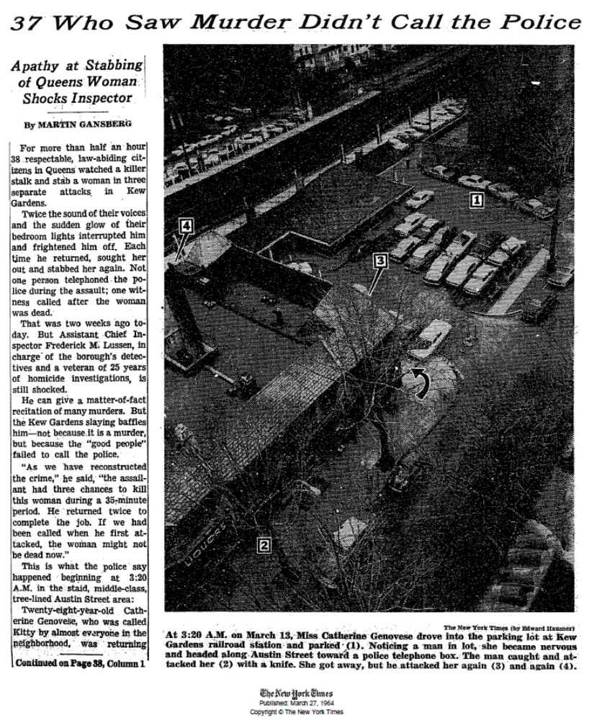
The shocking story of Kitty Genovese who was murdered in Queens, NY, while 38 witnesses listened to her screams but did nothing.
She was returning from work around 2:30 am on Mar 13, 1964 when a man with a knife grabbed her and stabbed her while she screamed.
This was on the front page of The New York Times.

Slide 26
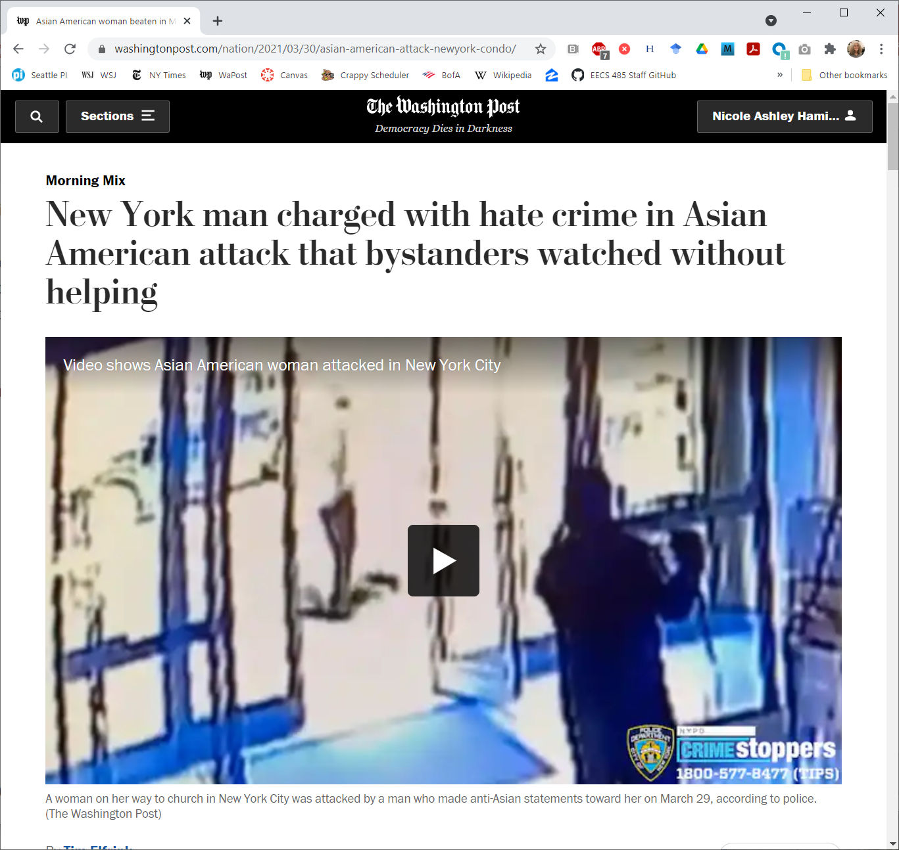
The doormen who watched from inside have been fired.

Slide 27
ethics
What does it mean to be fair?
What does it mean to be ethical?
When do you have specific duties, e.g., a duty to disclose?

Slide 28
What does it mean to be fair?

Slide 29
what does it mean to be fair?
Typical components:
Don’t take advantage of people.
Don’t abuse power over others.
Treat people equally.
Be tolerant.
Accept diversity.
Be open-minded.
Admit mistakes.

Slide 30
what does it mean to be ethical?
This is a tougher question.
What do we mean by ethics?

Slide 31
ethics
One possible definition:
Moral principles that govern a person’s behavior or the conduct of an activity.

Slide 32
branches of ethics
Normative
Meta-ethics
Applied ethics
Moral ethics
Descriptive

Slide 33
branches of ethics
Normative
Meta-ethics
Applied ethics
Moral ethics
Descriptive
How individuals figure out the correct moral action.

Slide 34
branches of ethics
Normative
Meta-ethics
Applied ethics
Moral ethics
Descriptive
The nature of ethical properties and judgements, e.g., truth, theory of moral principles.

Slide 35
branches of ethics
Normative
Meta-ethics
Applied ethics
Moral ethics
Descriptive
Applying theories to everyday life, e.g., should abortion be legal, should you report illegal behavior?

Slide 36
branches of ethics
Normative
Meta-ethics
Applied ethics
Moral ethics
Descriptive
How individuals develop morally, why morality differs between cultures, what is universal?

Slide 37
branches of ethics
Normative
Meta-ethics
Applied ethics
Moral ethics
Descriptive
How do people actually behave?
Also called scientific ethics.

Slide 38
summary of the branches
Normative How individuals figure out the correct moral action.
Meta-ethics The nature of ethical properties and judgements, e.g., truth, theory of moral principles.
Applied ethics Applying theories to everyday life, e.g., should abortion be legal, should you report illegal behavior?
Moral ethics How individuals develop morally, why morality differs between cultures, what is universal?
Descriptive How do people actually behave?

Slide 39
within applied ethics
Business ethics
Professional ethics
Personal ethics

Slide 40
within applied ethics
Business ethics
Professional ethics
Personal ethics
Business policies and practices regarding corporate governance, insider trading, bribery, discrimination, social responsibility, fiduciary responsibility, often set by law.

Slide 41
within applied ethics
Business ethics
Professional ethics
Personal ethics
Standards of behavior for a professional person, often written out as a code of ethics by a professional organization like the IEEE or set by law.

Slide 42
within applied ethics
Business ethics
Professional ethics
Personal ethics
What an individual believes about morality and right and wrong.

Slide 43
summary of applied ethics
Business ethics Business policies and practices regarding corporate governance, insider trading, bribery, discrimination, social responsibility, fiduciary responsibility, often set by law.
Professional ethics Standards of behavior for a professional person, often written out as a code of ethics by a professional organization like the IEEE or set by law.
Personal ethics What an individual believes about morality and right and wrong.

Slide 44
concepts
Information asymmetry
Reliance
Fiduciary responsibility
Duty to disclose

Slide 45
concepts
Information asymmetry
Reliance
Fiduciary responsibility
Duty to disclose
When one party has more or better information than the other and could take advantage of the other.

Slide 46
concepts
Information asymmetry
Reliance
Fiduciary responsibility
Duty to disclose
When one party to an agreement acts or changes their position based on the other’s claims.

Slide 47
concepts
Information asymmetry
Reliance
Fiduciary responsibility
Duty to disclose
A duty to act in the best interest of another.

Slide 48
concepts
Information asymmetry
Reliance
Fiduciary responsibility
Duty to disclose
A duty to act in the best interest of another.

Slide 49
concepts
Information asymmetry
Reliance
Fiduciary responsibility
Duty to disclose
A legal obligation to disclose information that may be contrary to your interests, e.g., known defects in a house you’re selling.

Slide 50
summary of concepts
Information asymmetry When one party has more or better information than the other and could take advantage of the other.
Reliance When one party to an agreement acts or changes their position based on the other’s claims.
Fiduciary responsibility A duty to act in the best interest of another.
Duty to disclose A legal obligation to disclose information that may be contrary to your interests, e.g., known defects in a house you’re selling.

Slide 51
professional ethics
Define standards of behavior for people working within a profession.
Generally designed to address the problems of information asymmetry and reliance.
Often written out as a code of ethics.
Examples
IEEE Code of Ethics
AMA Code of Medical Ethics
Society of Professional Journalists Code of Ethics

Slide 52
7.8 IEEE Code of Ethics
We, the members of the IEEE, in recognition of the importance of our technologies in affecting the quality of life throughout the world, and in accepting a personal obligation to our profession, its members and the communities we serve, do hereby commit ourselves to the highest ethical and professional conduct and agree:
to accept responsibility in making decisions consistent with the safety, health, and welfare of the public, and to disclose promptly factors that might endanger the public or the environment;
to avoid real or perceived conflicts of interest whenever possible, and to disclose them to affected parties when they do exist;
to be honest and realistic in stating claims or estimates based on available data;
to reject bribery in all its forms;
to improve the understanding of technology; its appropriate application, and potential consequences;
to maintain and improve our technical competence and to undertake technological tasks for others only if qualified by training or experience, or after full disclosure of pertinent limitations;
to seek, accept, and offer honest criticism of technical work, to acknowledge and correct errors, and to credit properly the contributions of others;
to treat fairly all persons and to not engage in acts of discrimination based on race, religion, gender, disability, age, national origin, sexual orientation, gender identity, or gender expression;
to avoid injuring others, their property, reputation, or employment by false or malicious action;
to assist colleagues and co-workers in their professional development and to support them in following this code of ethics.

Slide 53
AMA CODE OF MEDICAL ETHICS
Preamble
The medical profession has long subscribed to a body of ethical statements developed primarily for the benefit of the patient. As a member of this profession, a physician must recognize responsibility to patients first and foremost, as well as to society, to other health professionals, and to self. The following Principles adopted by the American Medical Association are not laws, but standards of conduct that define the essentials of honorable behavior for the physician.
Principles of medical ethics
A physician shall be dedicated to providing competent medical care, with compassion and respect for human dignity and rights.
A physician shall uphold the standards of professionalism, be honest in all professional interactions, and strive to report physicians deficient in character or competence, or engaging in fraud or deception, to appropriate entities.
A physician shall respect the law and also recognize a responsibility to seek changes in those requirements which are contrary to the best interests of the patient.
A physician shall respect the rights of patients, colleagues, and other health professionals, and shall safeguard patient confidences and privacy within the constraints of the law.
A physician shall continue to study, apply, and advance scientific knowledge, maintain a commitment to medical education, make relevant information available to patients, colleagues, and the public, obtain consultation, and use the talents of other health professionals when indicated.
A physician shall, in the provision of appropriate patient care, except in emergencies, be free to choose whom to serve, with whom to associate, and the environment in which to provide medical care.
A physician shall recognize a responsibility to participate in activities contributing to the improvement of the community and the betterment of public health.
A physician shall, while caring for a patient, regard responsibility to the patient as paramount.
A physician shall support access to medical care for all people.

Slide 54
Society of Professional Journalists Code of Ethics
Seek Truth and Report It.
Minimize Harm.
Act Independently.
Be Accountable and Transparent.

Slide 55
Seek Truth and Report It
Ethical journalism should be accurate and fair. Journalists should be honest and courageous in gathering, reporting and interpreting information.
Journalists should:
– Take responsibility for the accuracy of their work. Verify information before releasing it. Use original sources whenever possible.
– Remember that neither speed nor format excuses inaccuracy.
– Provide context. Take special care not to misrepresent or oversimplify in promoting, previewing or summarizing a story.
– Gather, update and correct information throughout the life of a news story.
– Be cautious when making promises, but keep the promises they make.
– Identify sources clearly. The public is entitled to as much information as possible to judge the reliability and motivations of sources.
– Consider sources’ motives before promising anonymity. Reserve anonymity for sources who may face danger, retribution or other harm, and have information that cannot be obtained elsewhere. Explain why anonymity was granted.
– Diligently seek subjects of news coverage to allow them to respond to criticism or allegations of wrongdoing.
– Avoid undercover or other surreptitious methods of gathering information unless traditional, open methods will not yield information vital to the public.
– Be vigilant and courageous about holding those with power accountable. Give voice to the voiceless.
– Support the open and civil exchange of views, even views they find repugnant.
– Recognize a special obligation to serve as watchdogs over public affairs and government. Seek to ensure that the public’s business is conducted in the open, and that public records are open to all.
– Provide access to source material when it is relevant and appropriate.
– Boldly tell the story of the diversity and magnitude of the human experience. Seek sources whose voices we seldom hear.
– Avoid stereotyping. Journalists should examine the ways their values and experiences may shape their reporting.
– Label advocacy and commentary.
– Never deliberately distort facts or context, including visual information. Clearly label illustrations and re-enactments.
– Never plagiarize. Always attribute.

Slide 56
agenda
details
tee shirts
where you should be
how to be successful
ethics
the intersection of ethics and technology

Slide 57
the intersection of ethics and technology
We are entering a world where everything will be captured somewhere as digital data.
Electronic surveillance is happening.
You’ll likely be on camera and recorded much of your waking life.
Your cellphone will provide a GPS record of where you went.
The government and others may be monitoring your electronic conversations.
Certainly, anything you voluntarily post or share will never go away.

Slide 58
the intersection of ethics and technology
As computer scientists and engineers, you will decide how society uses your work.

Slide 59
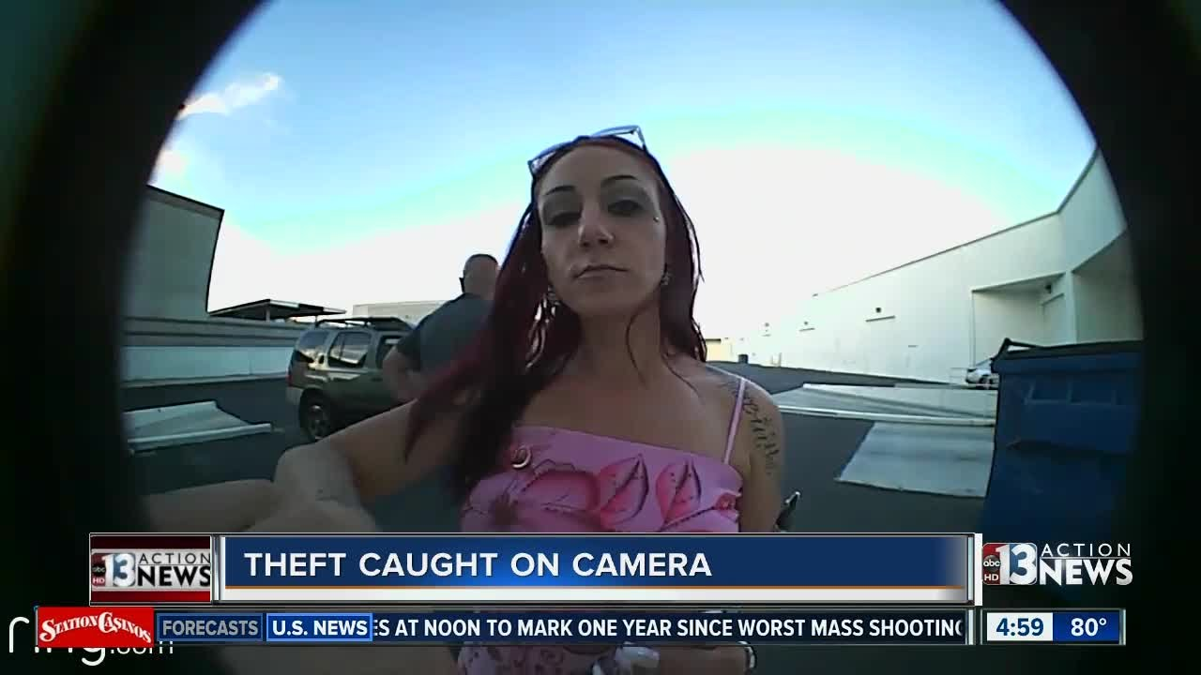
Cameras are now everywhere.

Slide 60
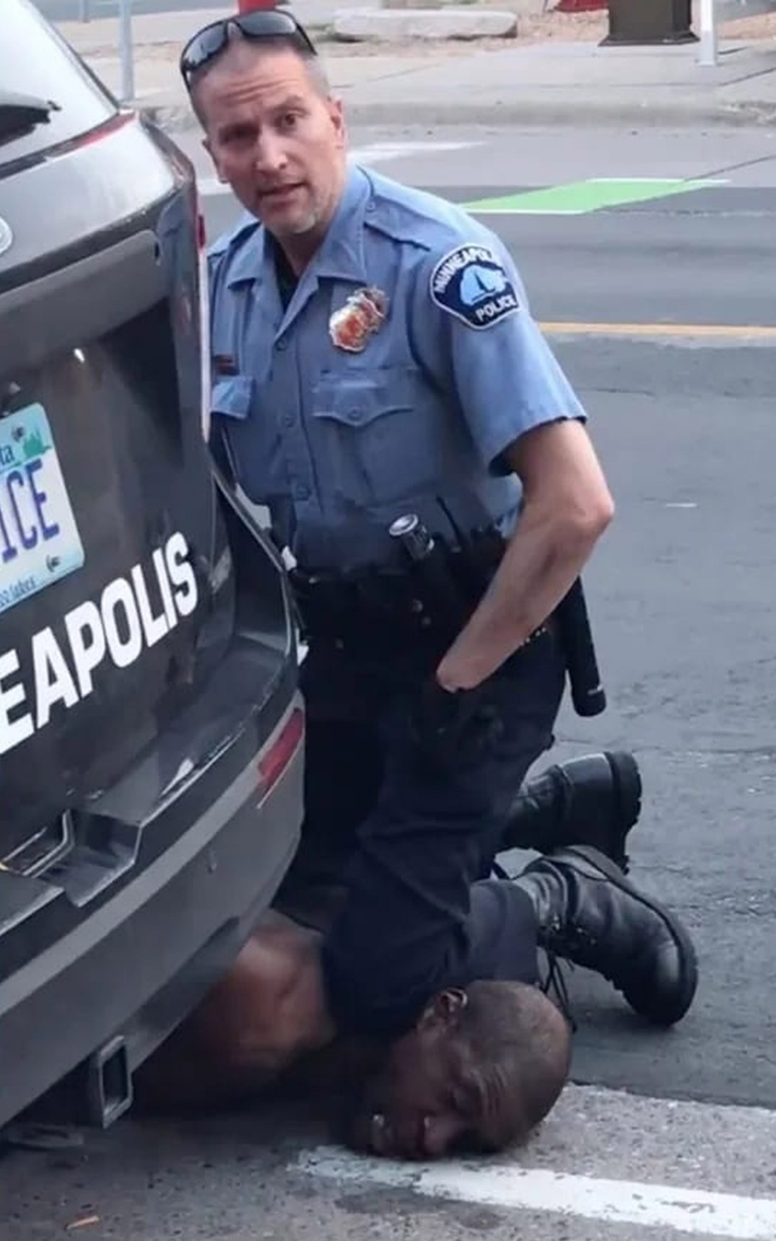
Derek Chauvin, kneeling on George Floyd’s neck, caught on cellphone.

Slide 61
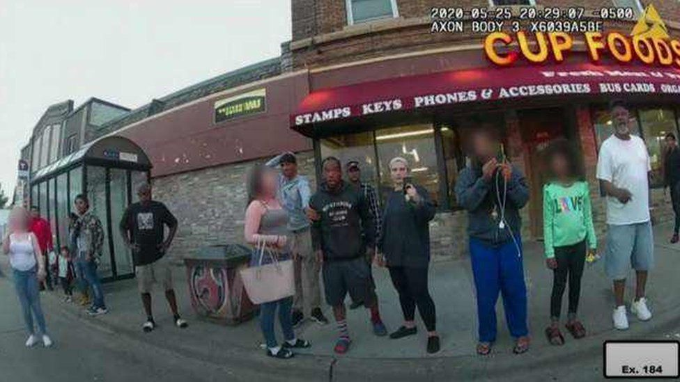
The witnesses, caught on Derek Chauvin’s bodycam.

Slide 62
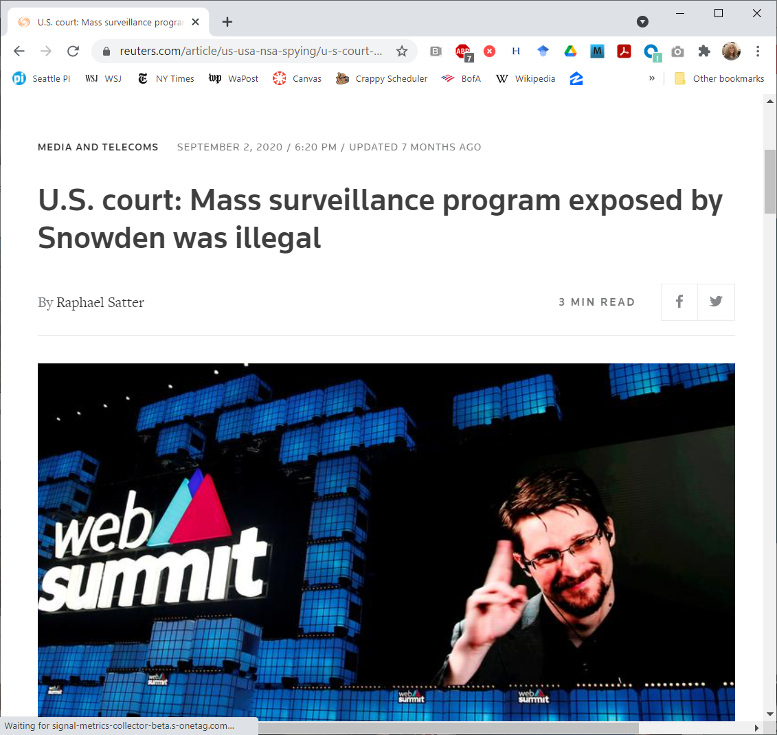
Governments spy on us.
Snowden revealed that the NSA was conducting mass surveillance on Americans’ telephone records in 2013.

Slide 63
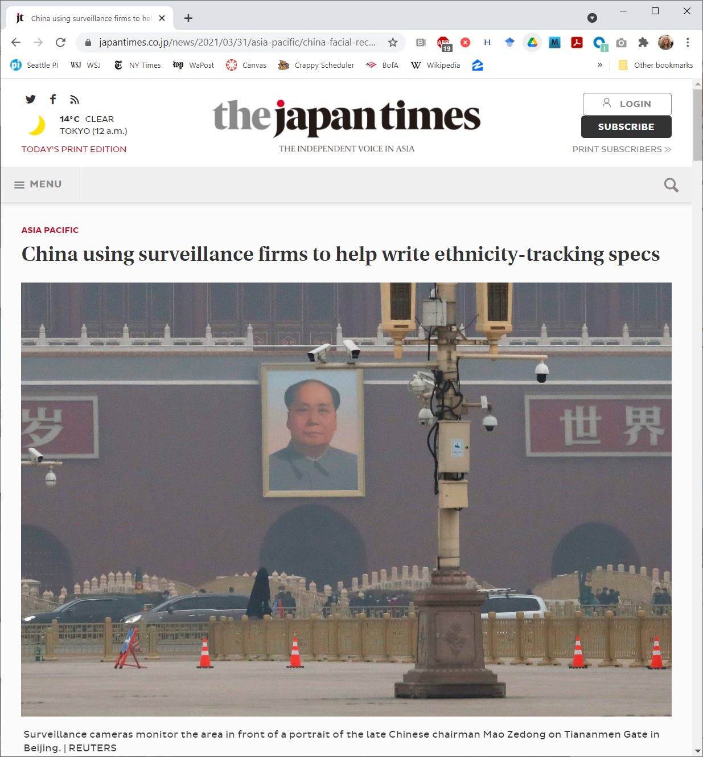
China used electronic surveillance during the pandemic to enforce stay at home orders.
But they’ve also used it for other purposes.

Slide 64
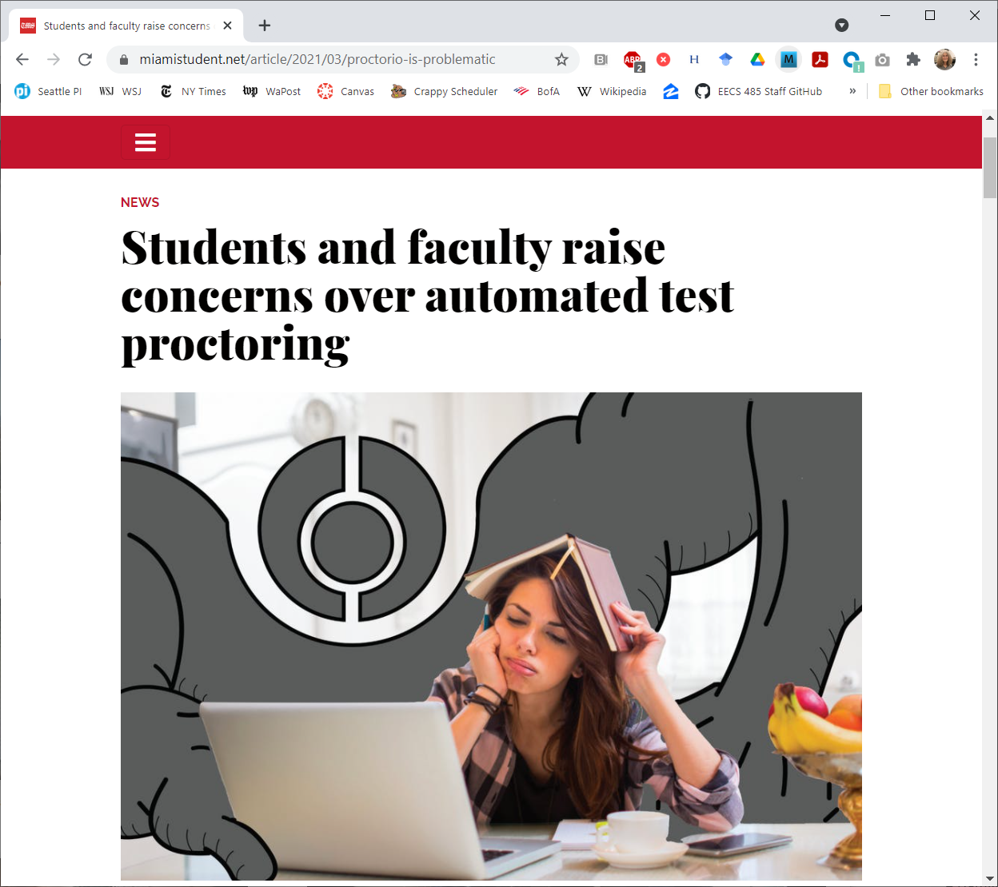
Cameras and other proctoring techniques were briefly considered here at Umich during Covid.
With rising concerns about cheating, there are new proposals to allow proctoring for exams, including electronic proctoring for online exams.

Slide 65
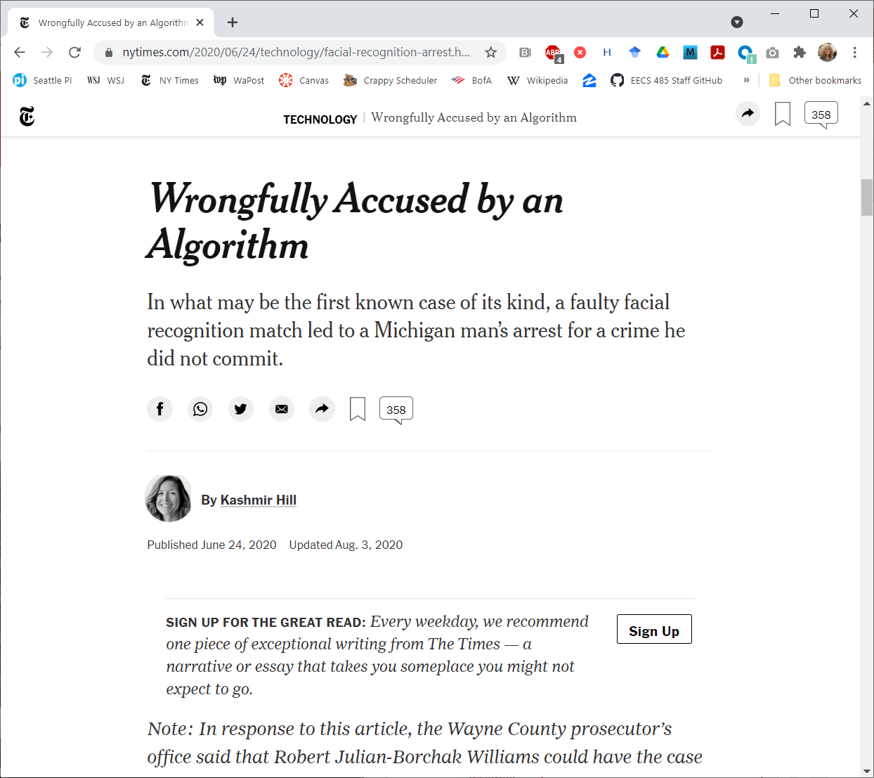
Facial recognition is being more widely used, especially by police.
It’s not always right.

Slide 66
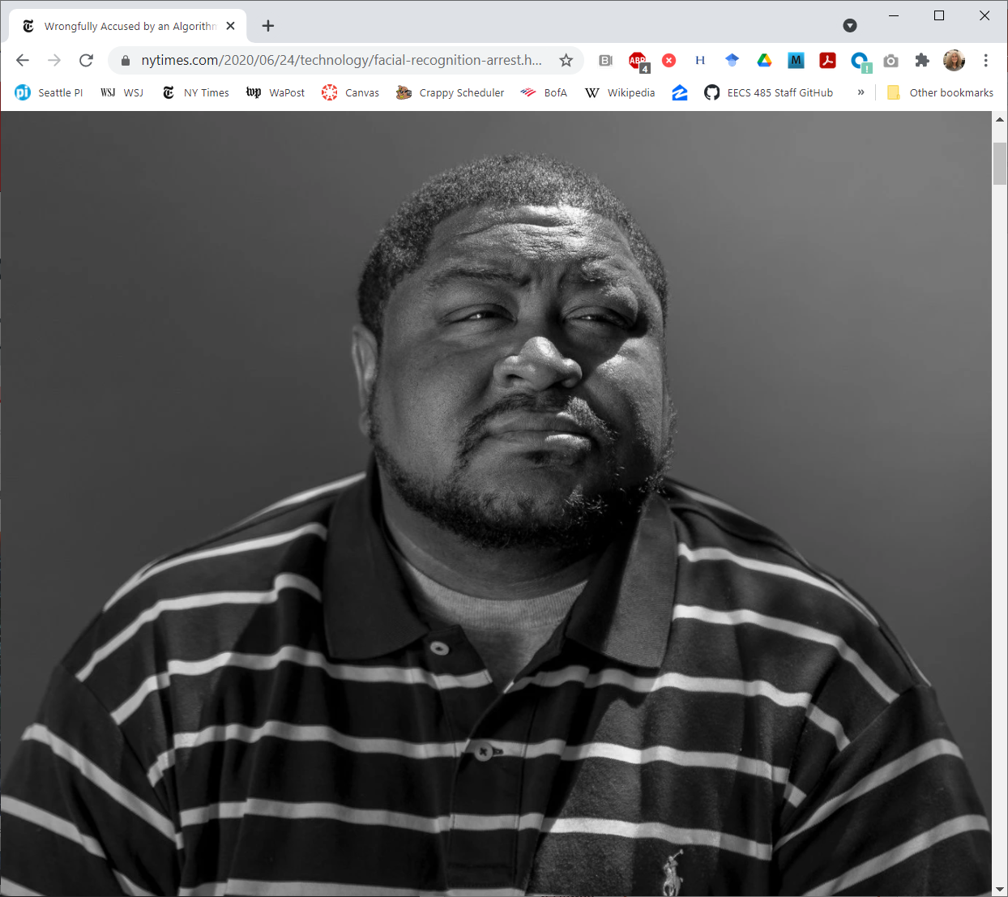
This was the individual.
Facial recognition software tends to be less accurate with people of color.

Slide 67
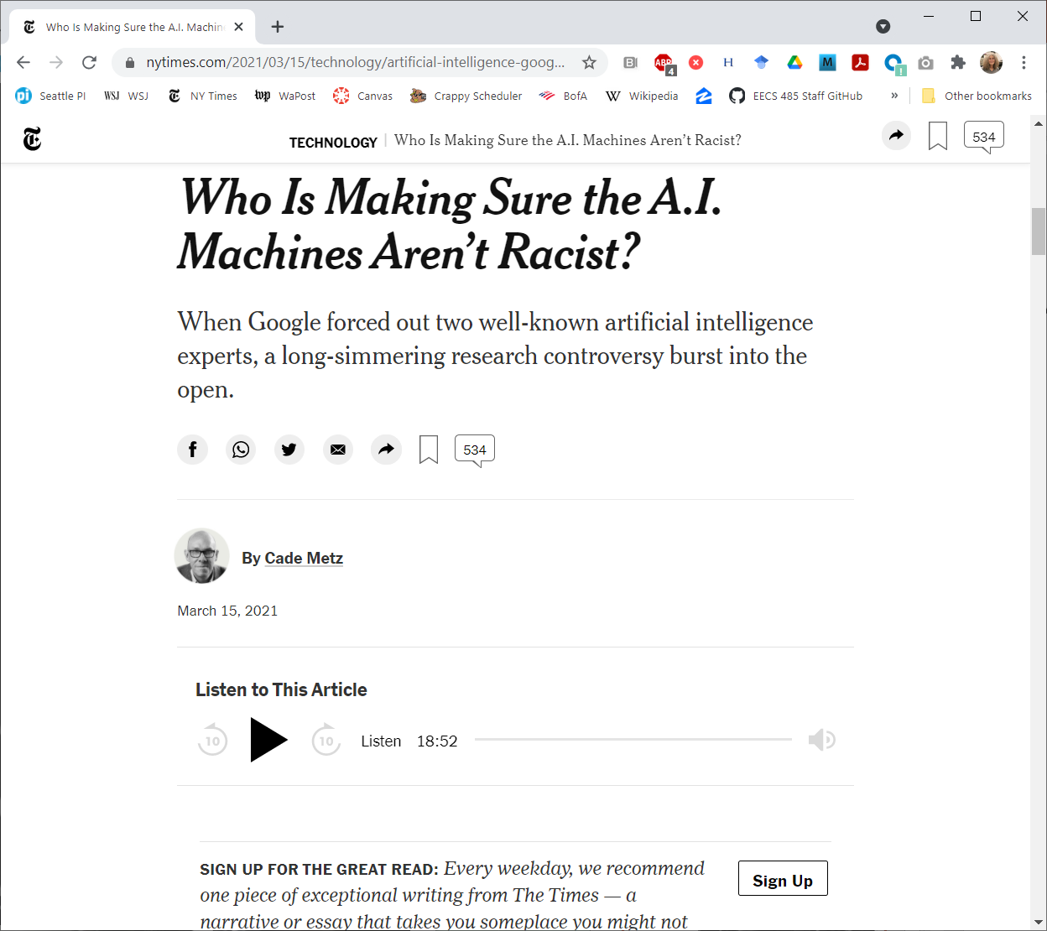
Who is looking out for us?
Google fired the young Black woman they’d hired to build their Ethical AI team after she criticized their approach to minority hiring.

Slide 68
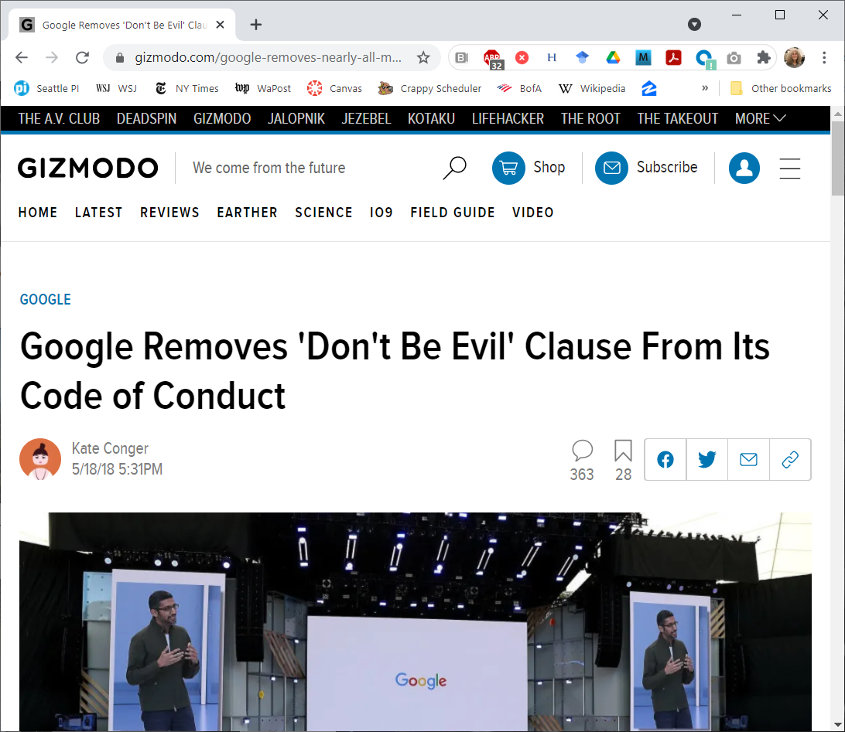
Speaks for itself.

Slide 69
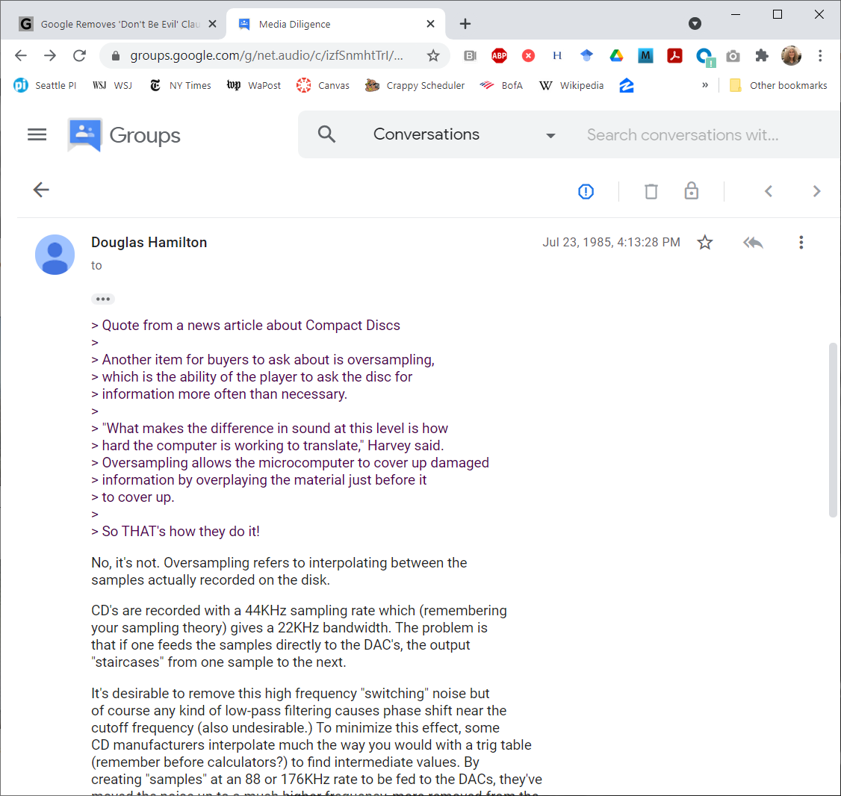
Anything you post will never go away.
This was a comment about oversampling in CD players that I posted to the net.audio Usenet group in July 23, 1985. It’s still there on the web.
(Thank goodness I was right.)

Slide 70
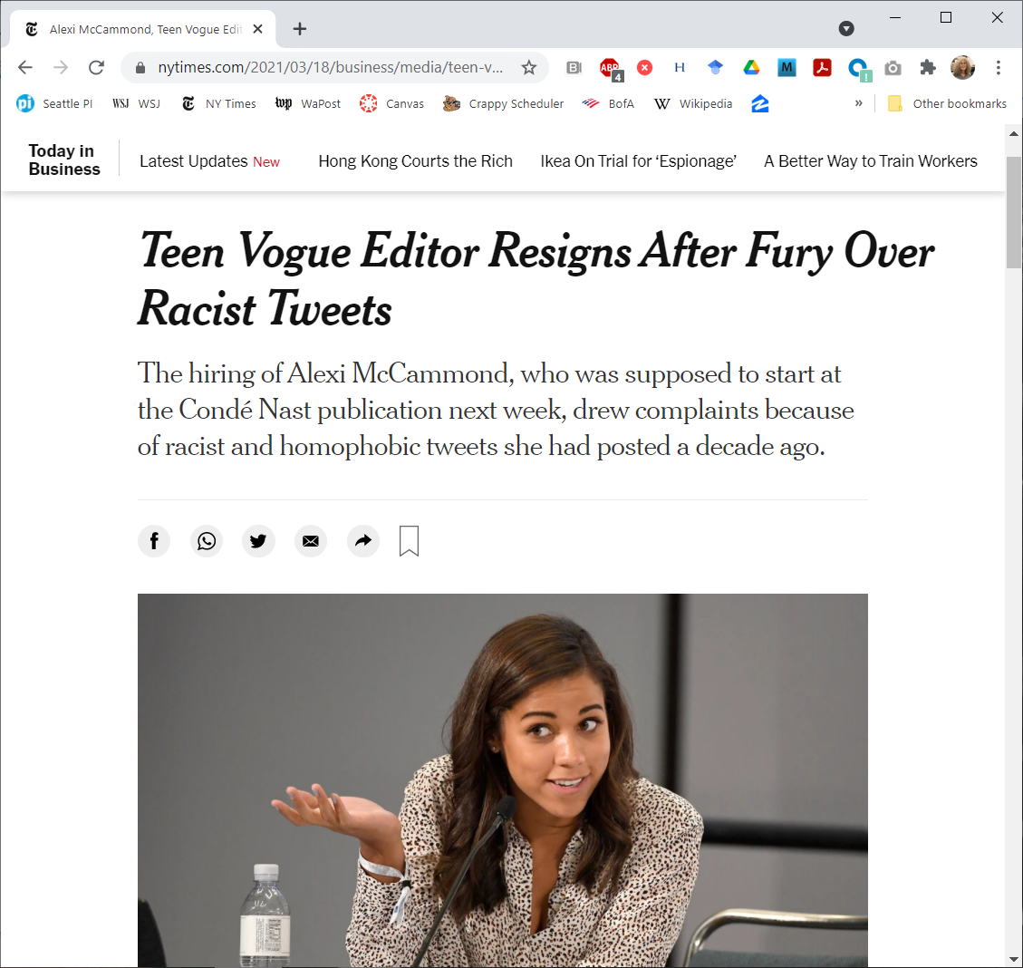
Alexi McCammond was hired, then fired after anti-Asian Tweets she’d posted as college freshman a decade earlier surfaced.

Slide 71
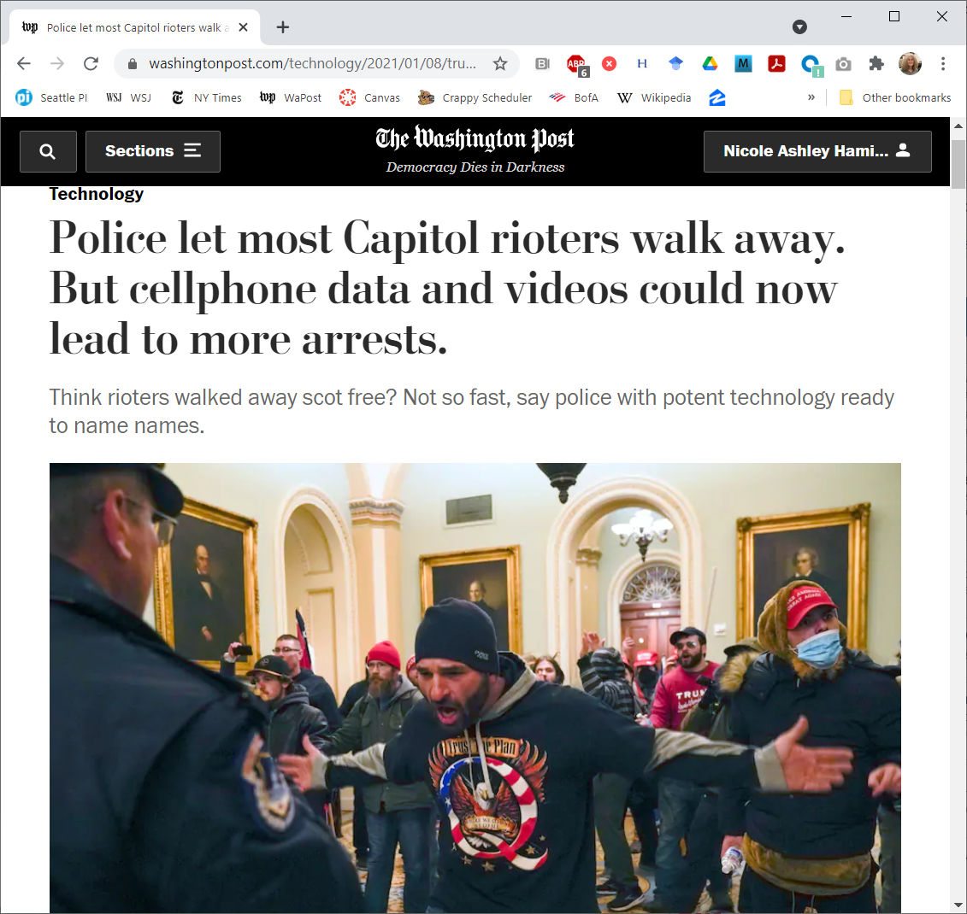
Capitol rioters were undone by their own selfies.
Until Trump pardoned them as patriots during their day of love.

Slide 72
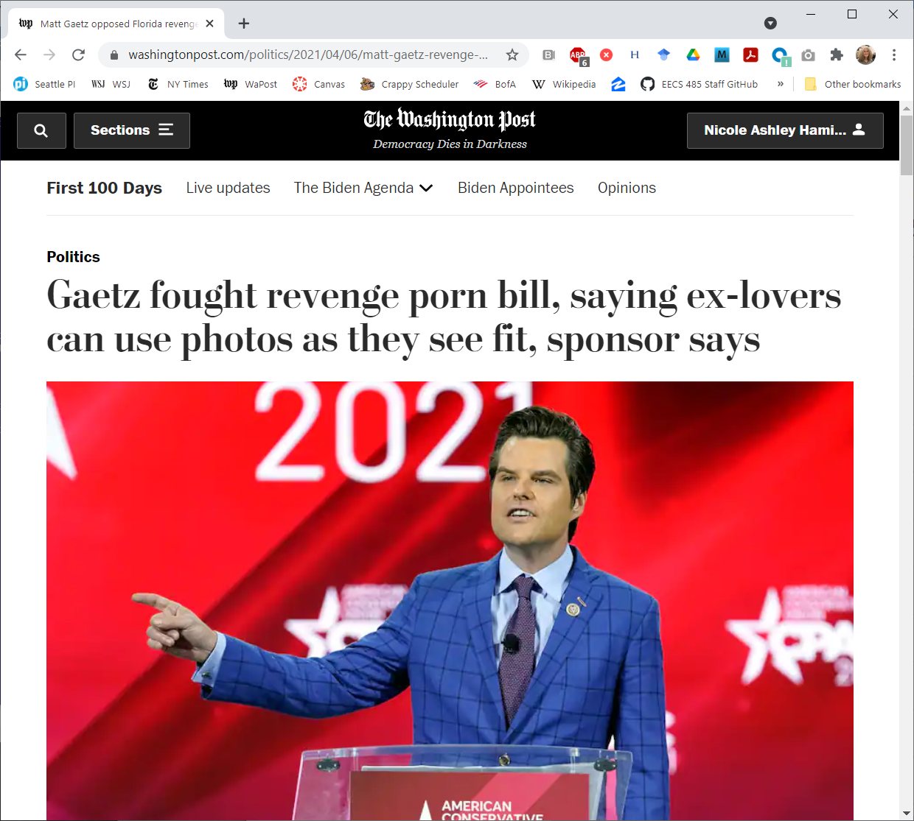
Gaetz is reported to have shown nude videos of his sexual partners to other members of Congress.
He was eventually forced to resign in November 2024.

Slide 73
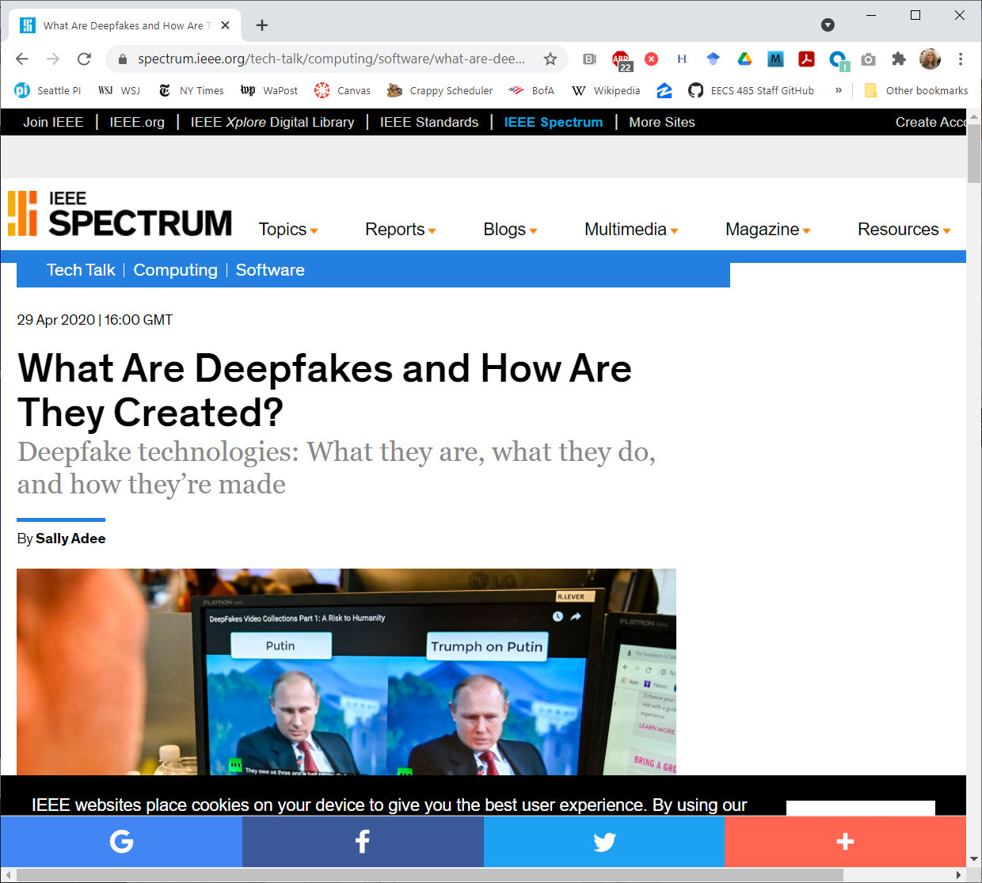
How will you know what is real?

Slide 74
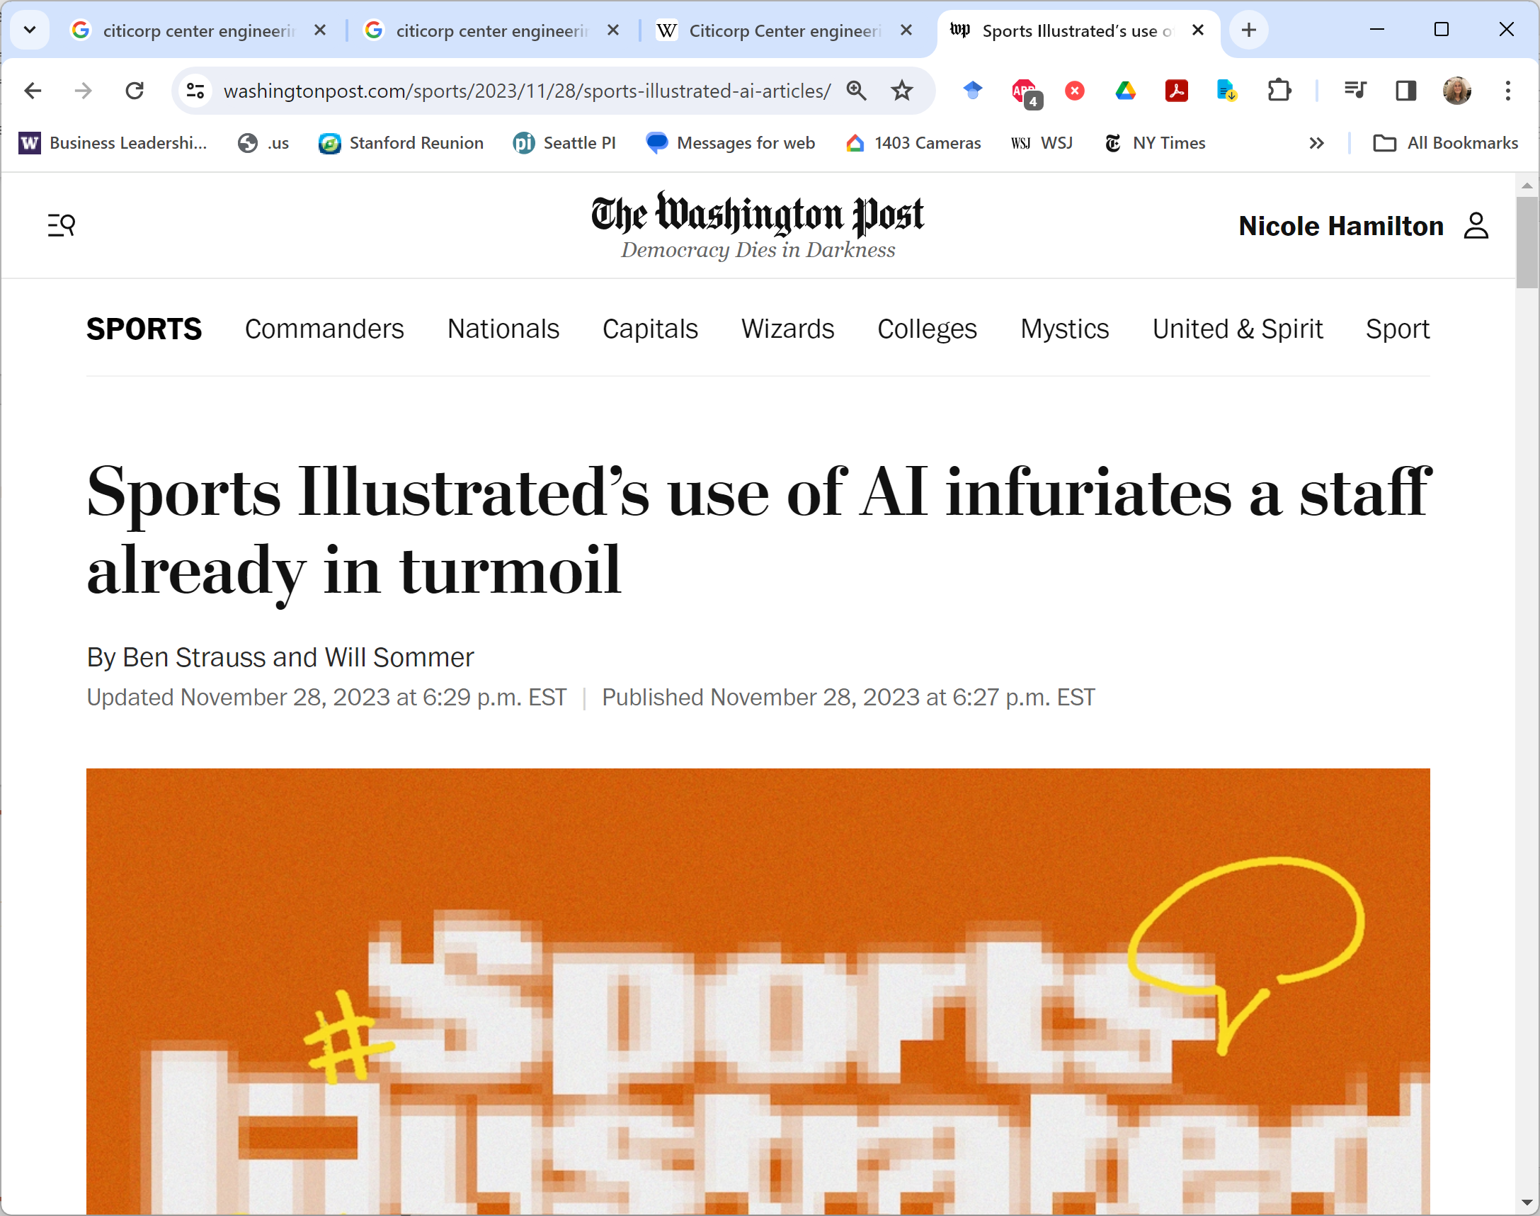
Generative AI may replace us all with an avalanche of fake news.

Slide 75
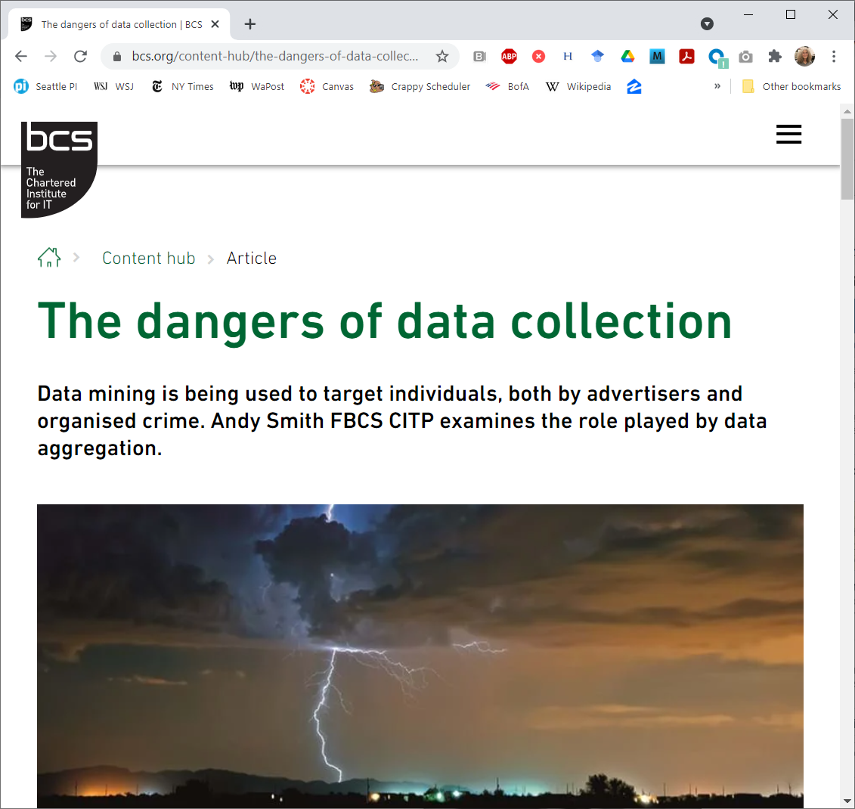
By aggregating enough data from enough public and private sources allows a lot of personal information to be revealed.

Slide 76
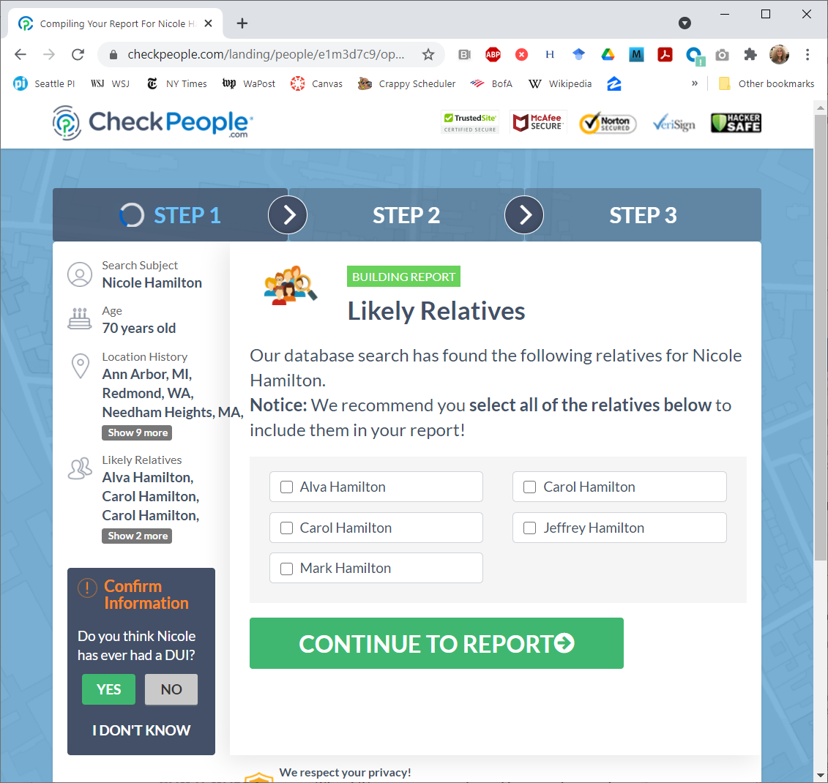
Court records are public. But you had to go there and do the search yourself. Now websites will do it for you.
Yes, those are all relatives.

Slide 77
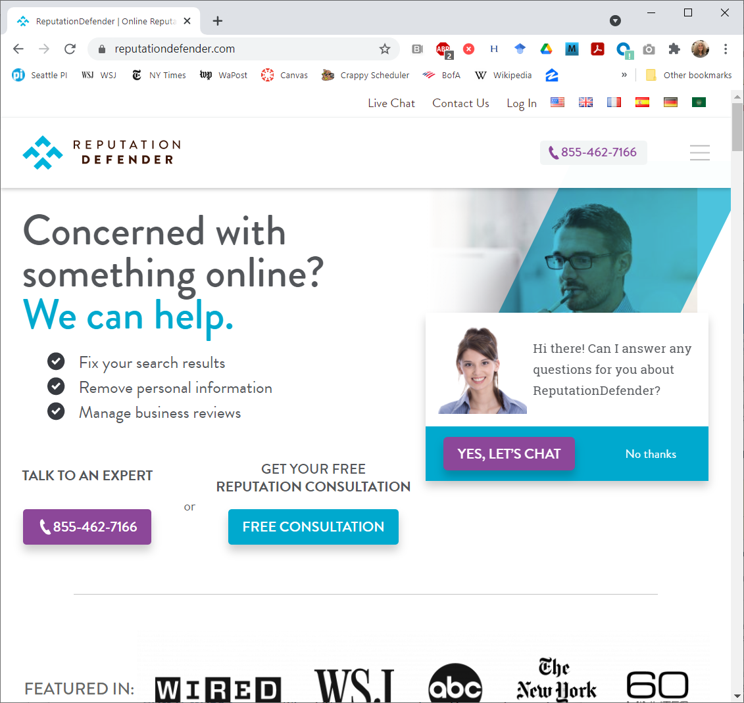
There’s now an industry of companies that will clean up your online presence.

Slide 78
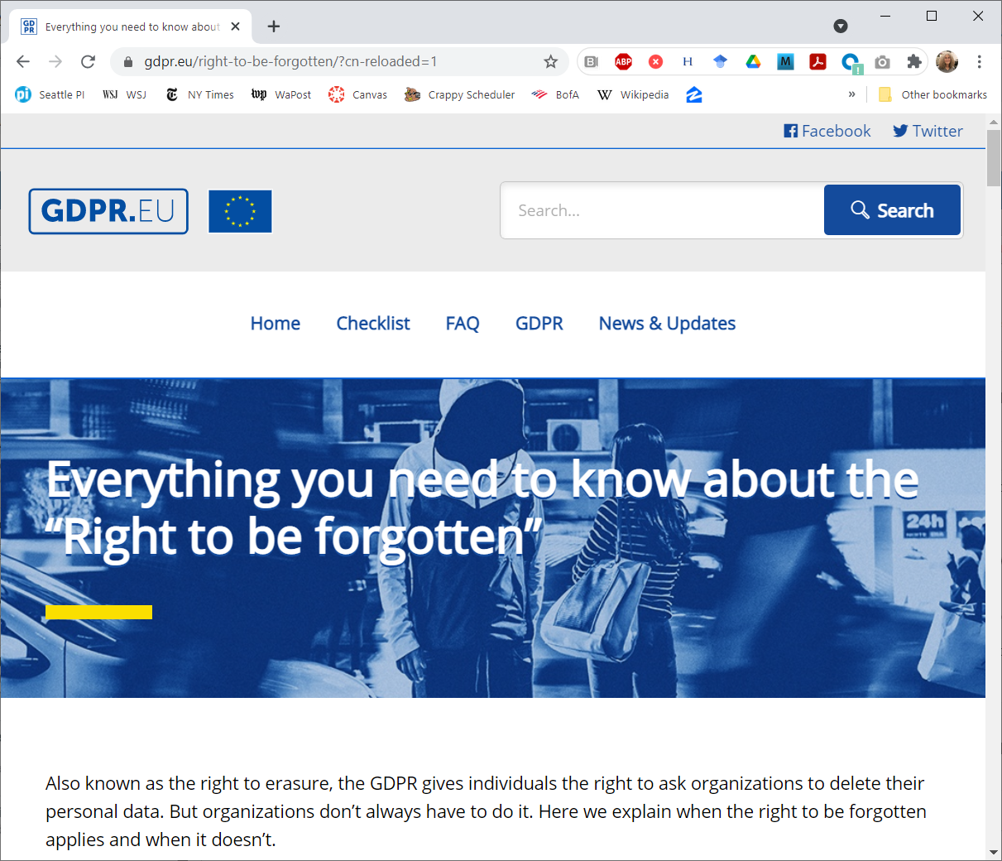
Europe recognizes a right to be forgotten.
The US does not.

Slide 79
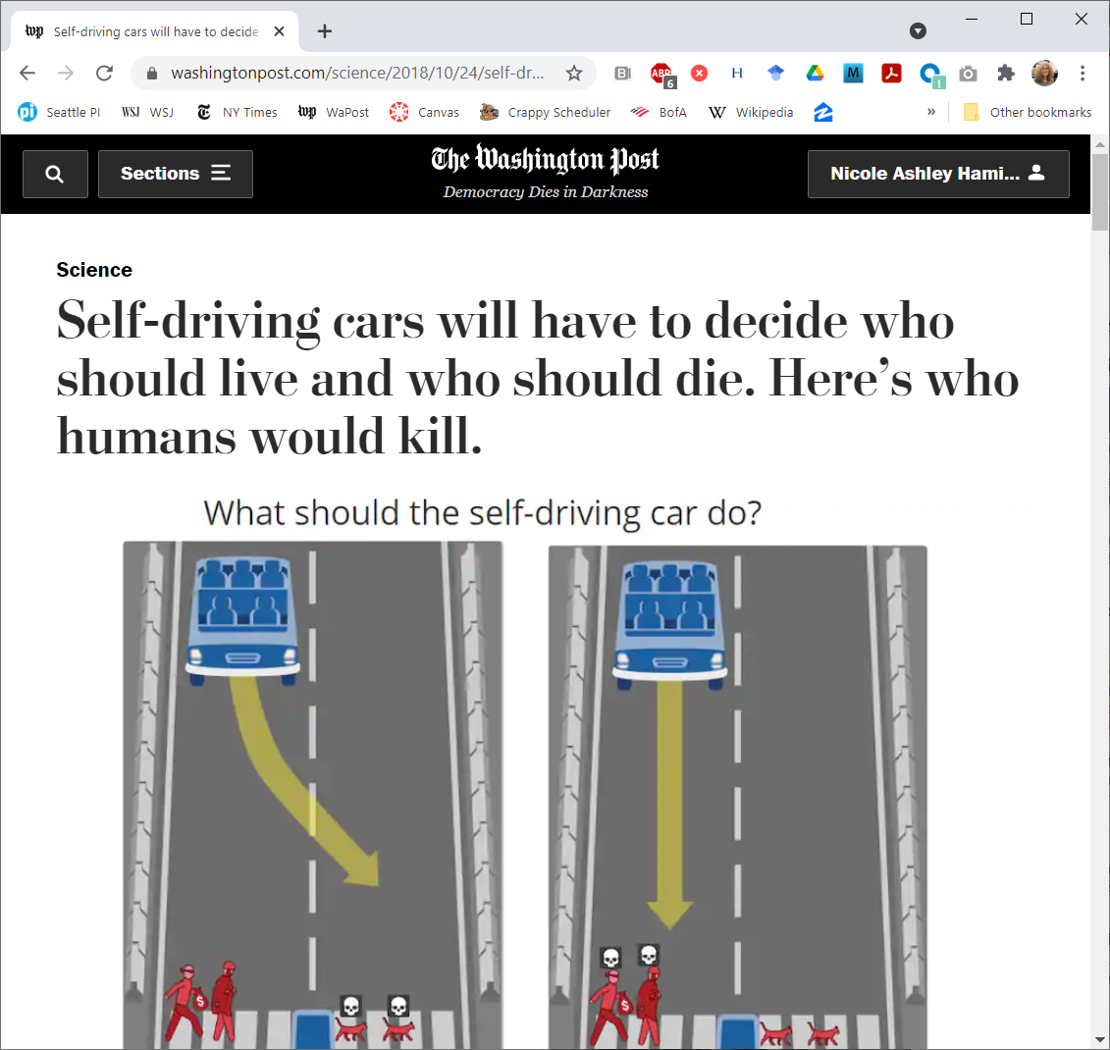
Cars will decide who should live.

Slide 80
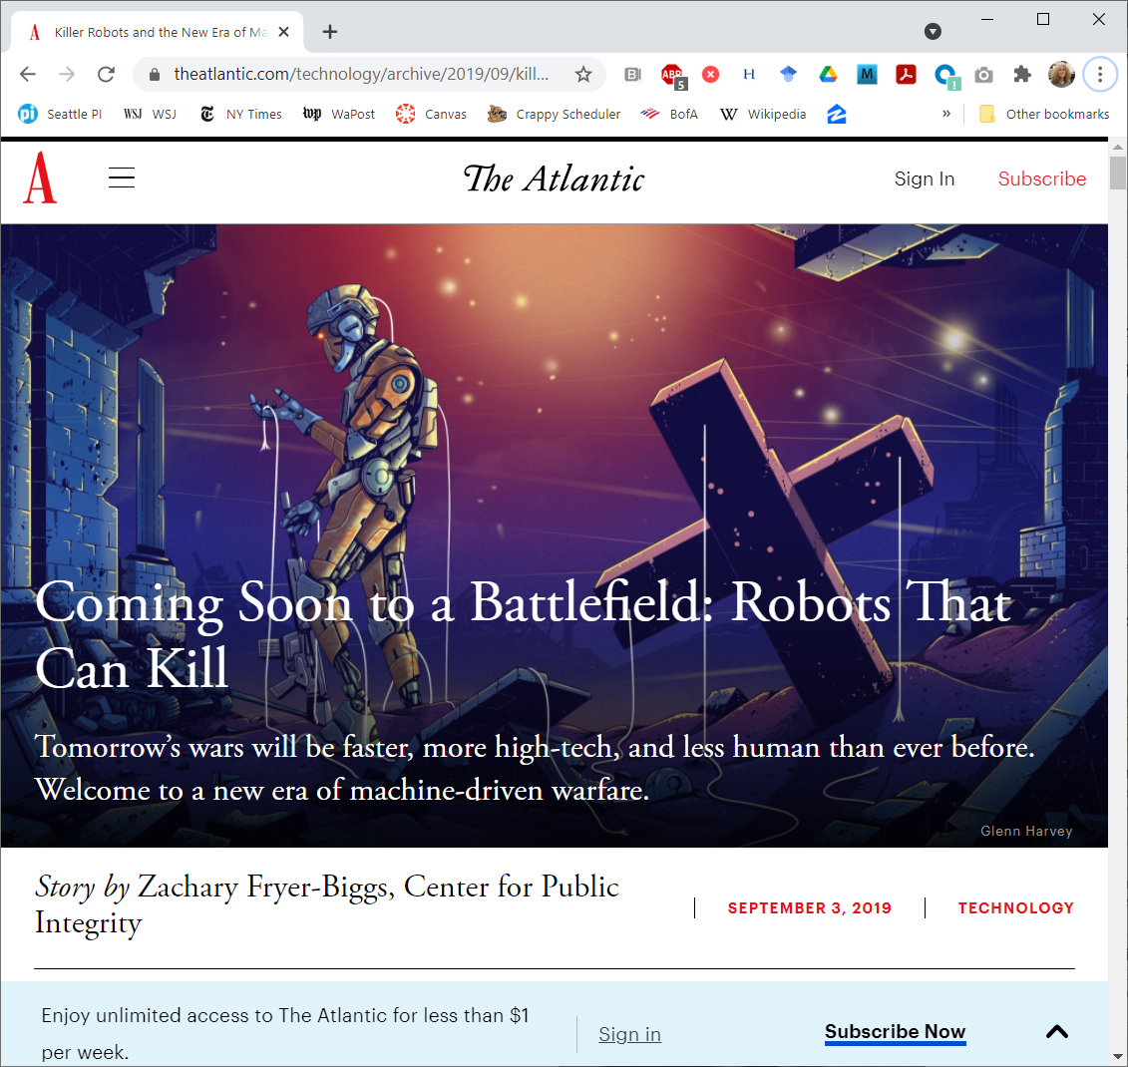
And real terminators will decide who should die.

Slide 81
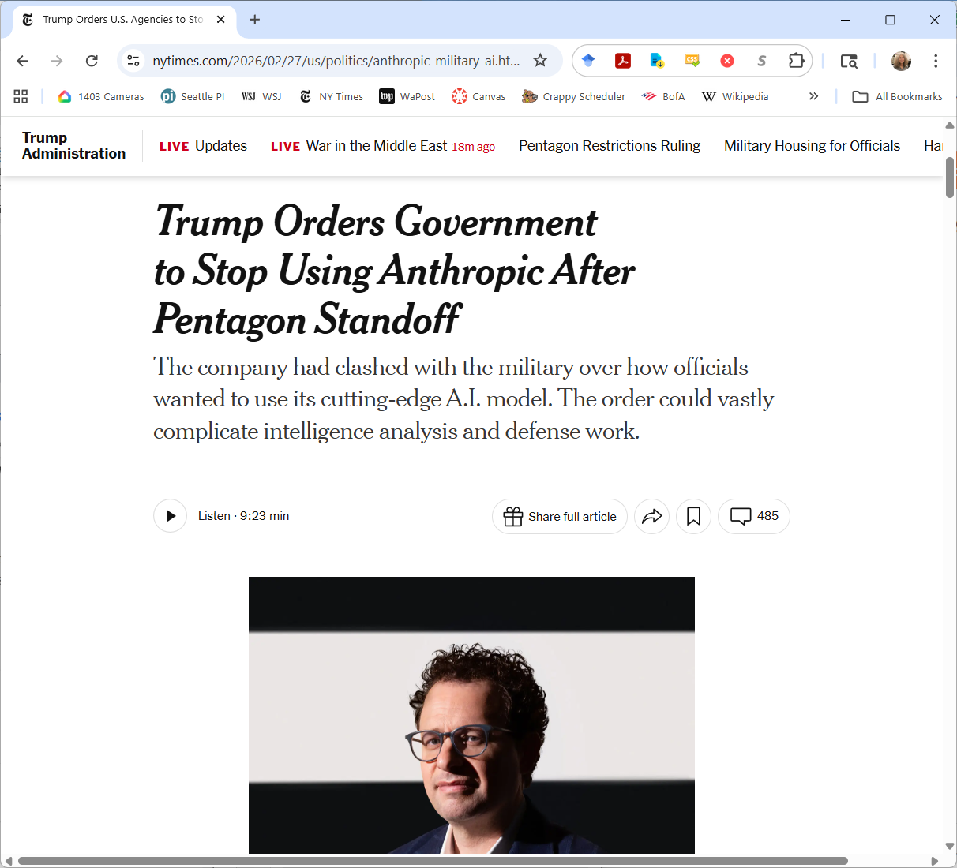
Standing up for your ethical principles can be costly.

Slide 82
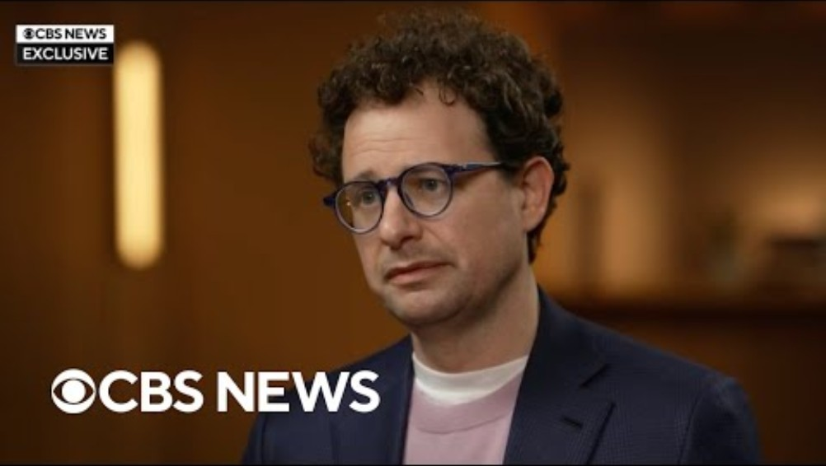
https://www.youtube.com/watch?v=QFDz6q-Qthk

Slide 83
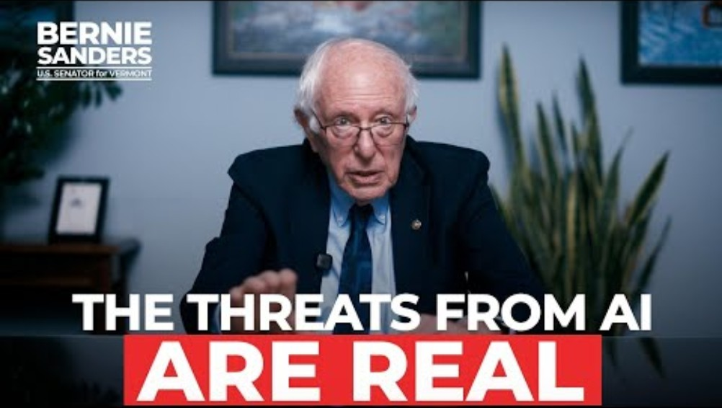
https://www.youtube.com/watch?v=K3qS345gAWI&t=9s

Slide 84
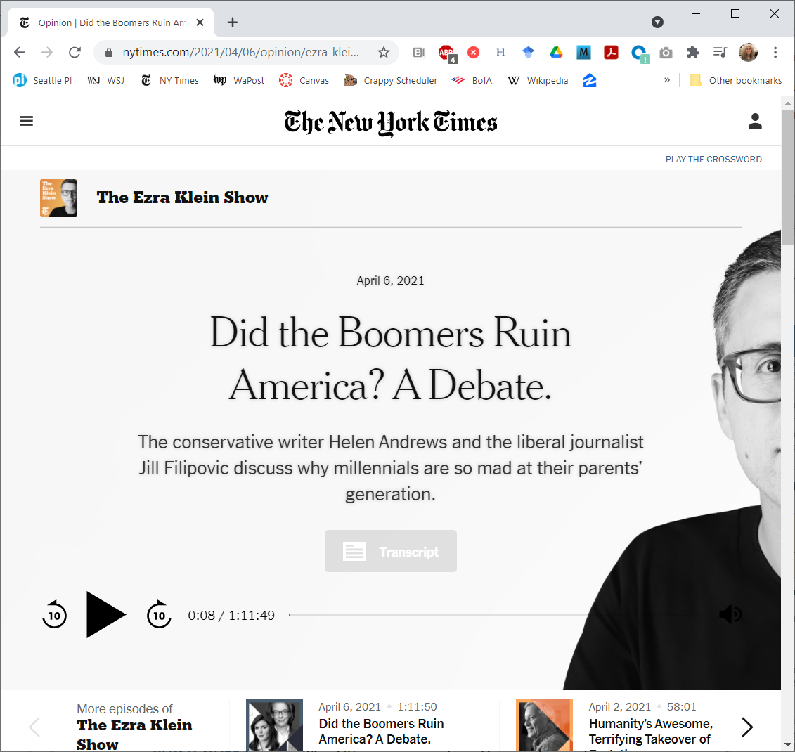
Your generation will have to fix it.

